Slide 1


Belle

Slide 2
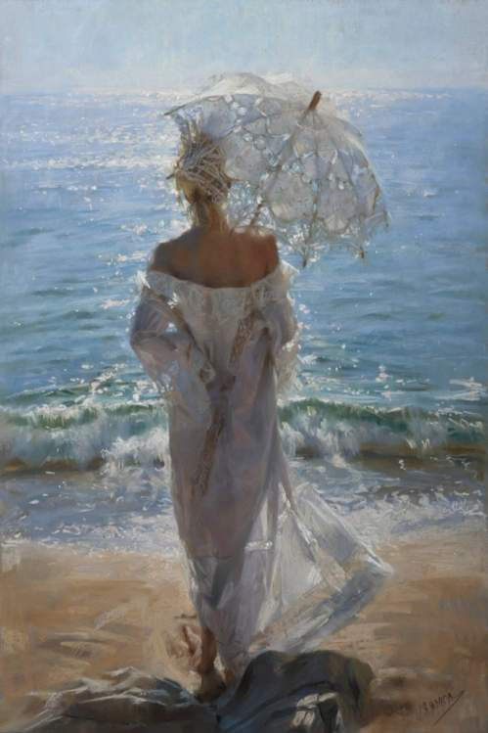
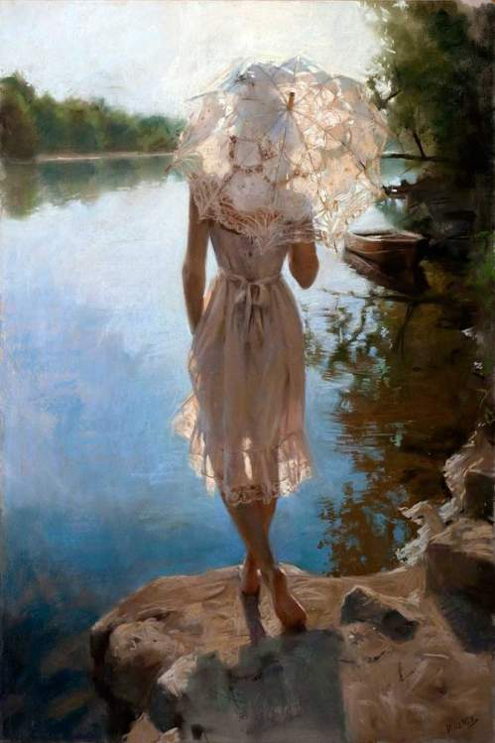

Slide 3
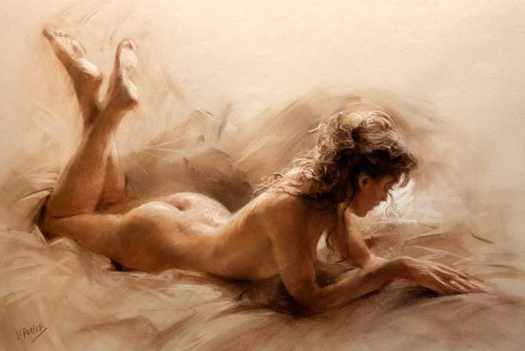


Slide 4
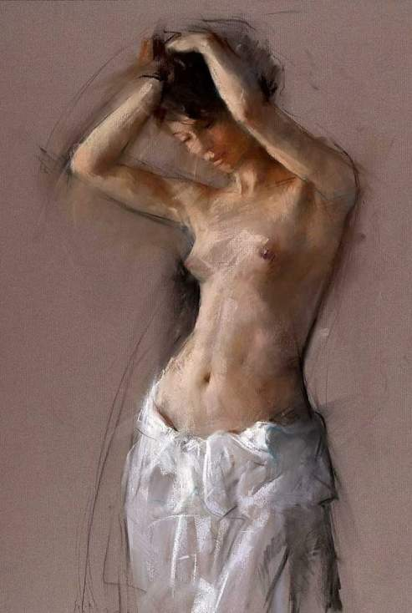
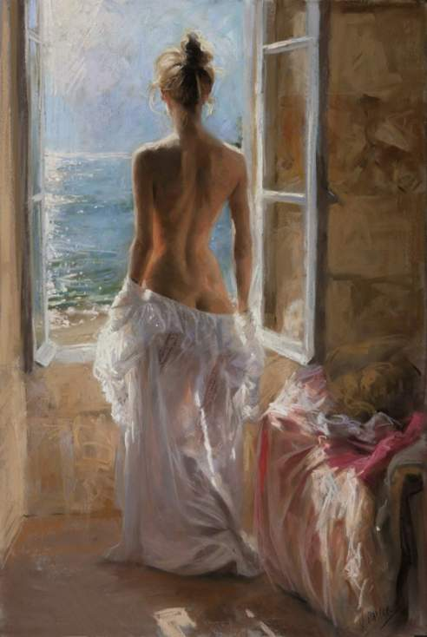

Slide 5
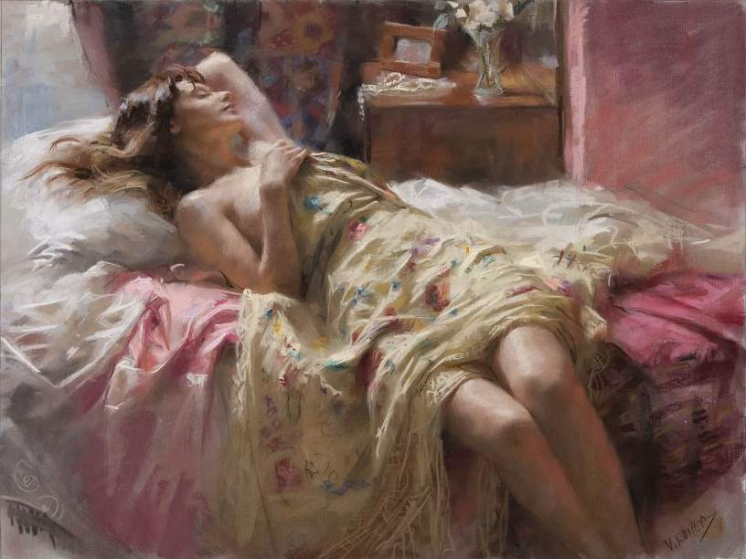

Slide 6


Slide 7
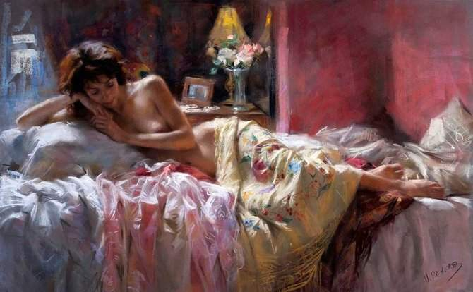

Slide 8


Slide 9


Slide 10
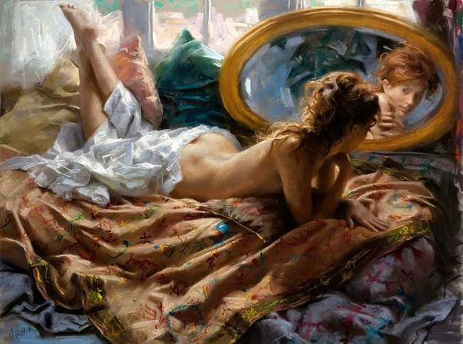

Slide 11

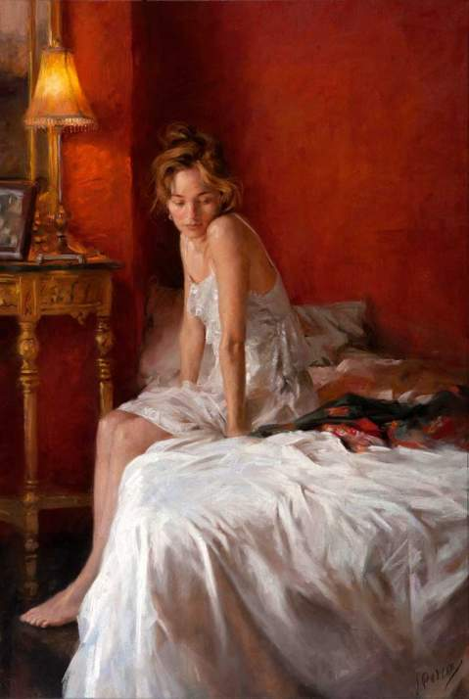

Slide 12


Slide 13
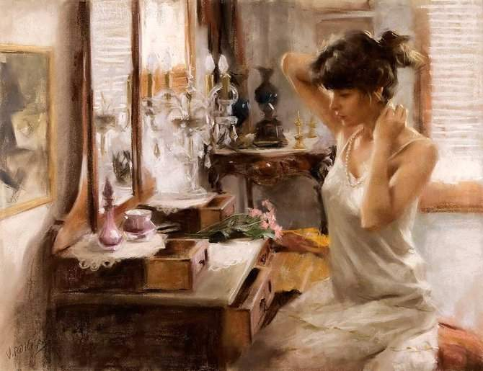

Slide 14
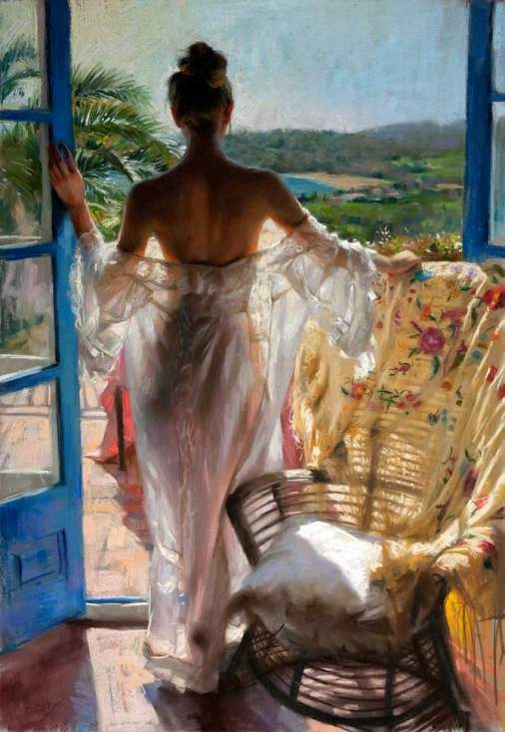
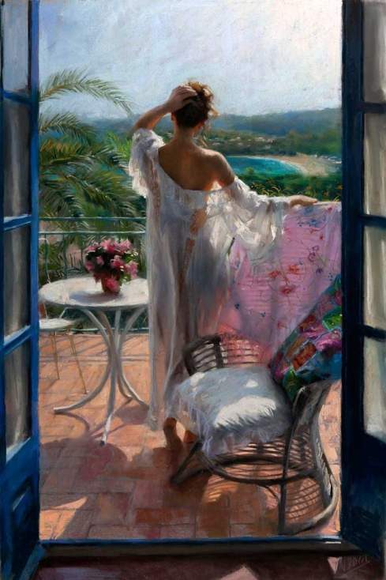

Slide 15
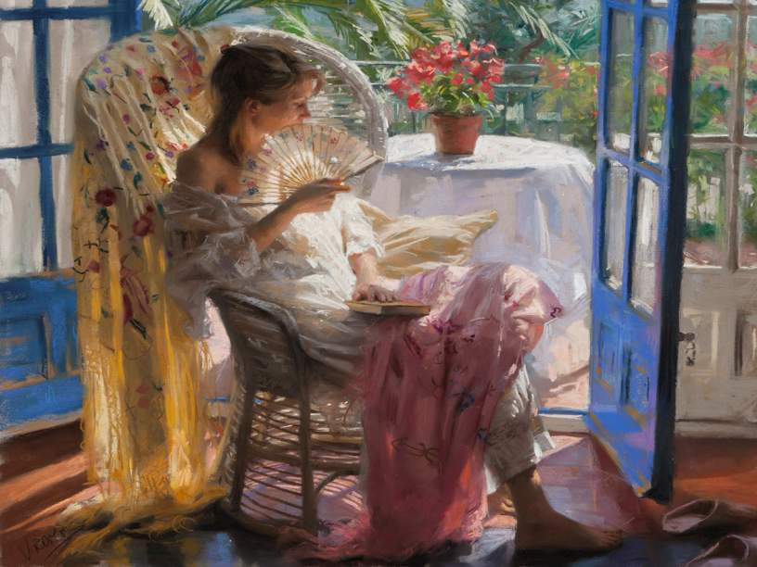

Slide 16
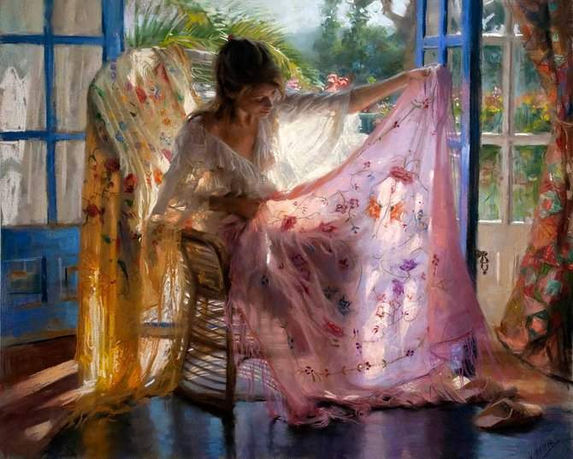

Slide 17
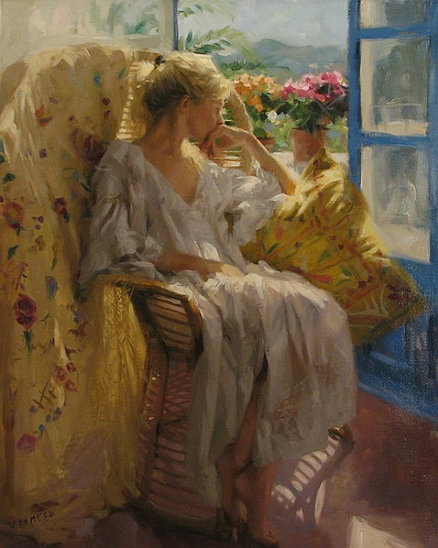


Slide 18
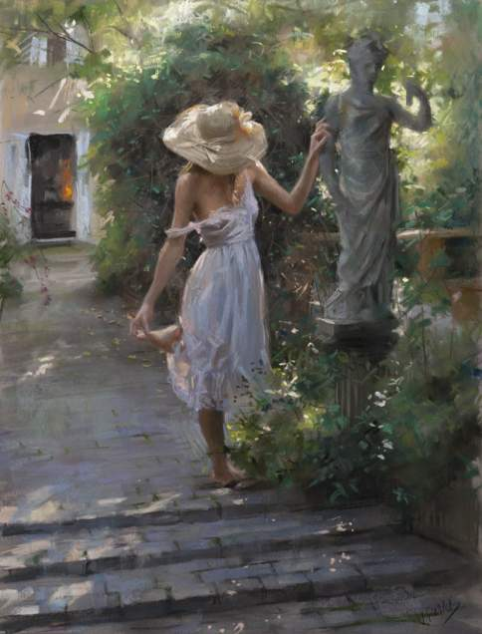

Slide 19
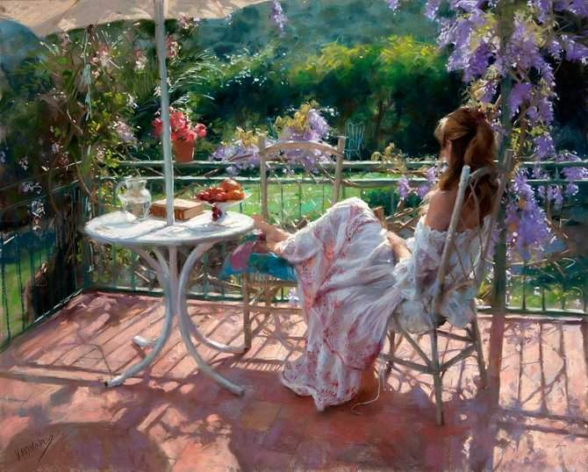

Slide 20

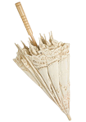

Slide 21


Slide 22


Slide 23
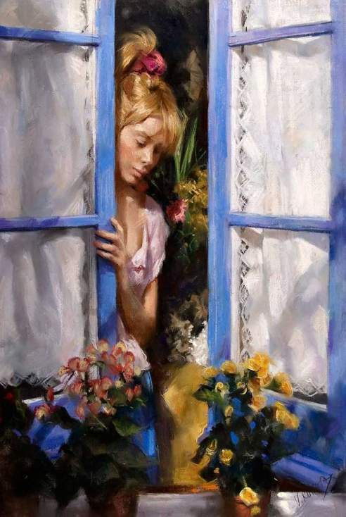
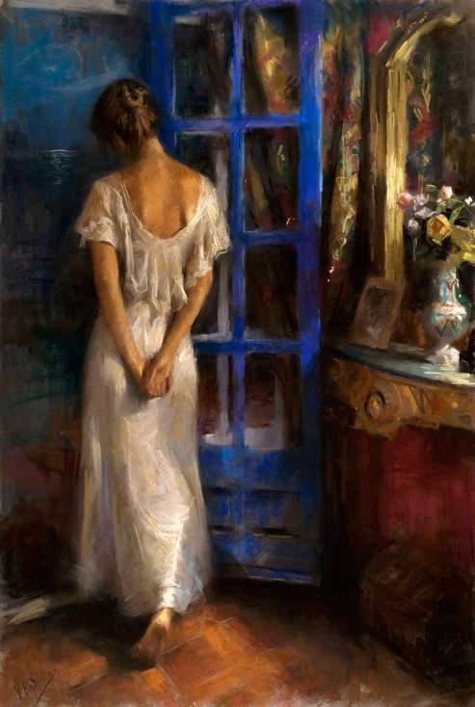

Slide 24



Slide 25

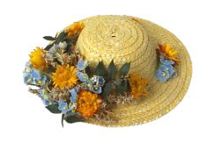

Slide 26
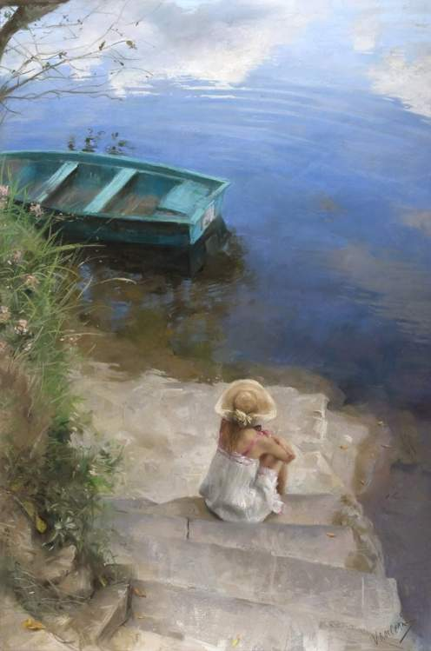
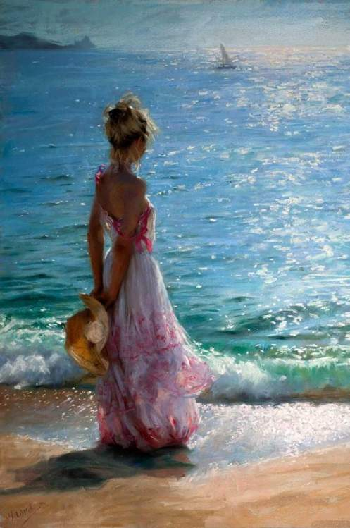


Slide 27

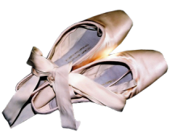

Slide 28
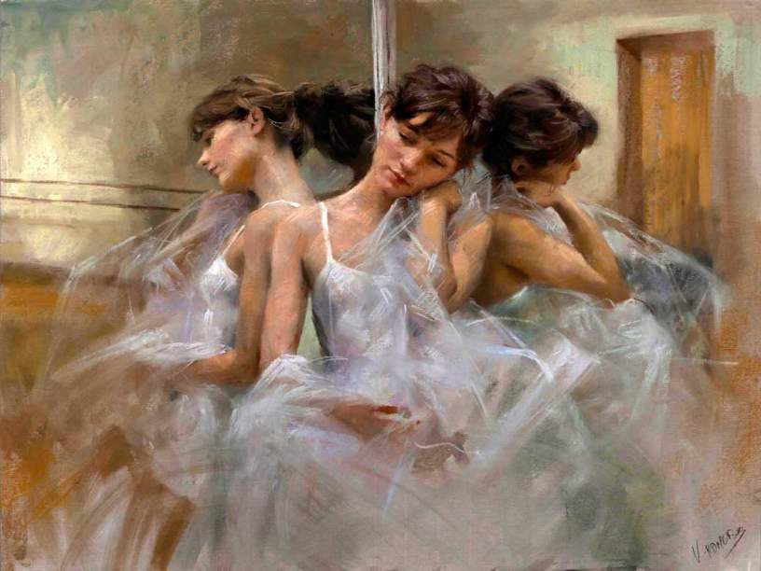

Slide 29
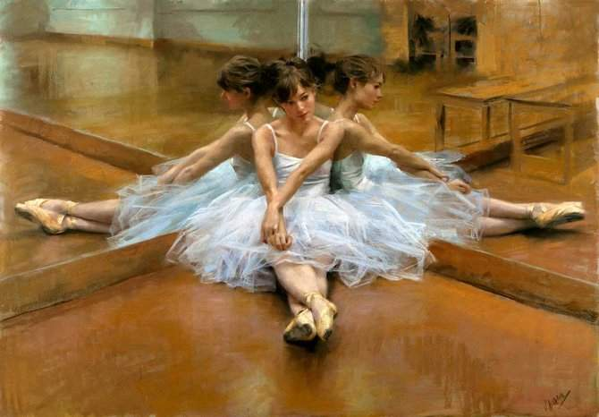

Slide 30
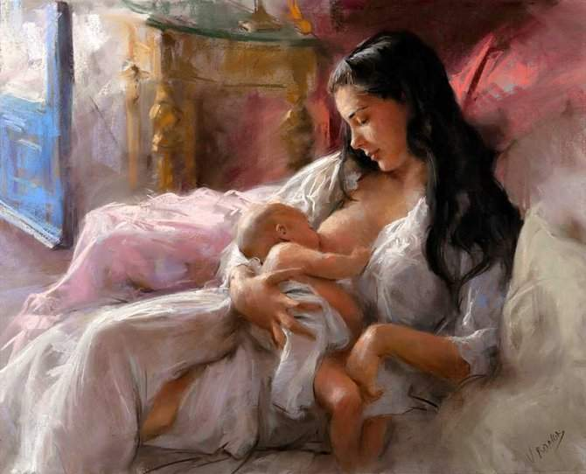

Slide 31
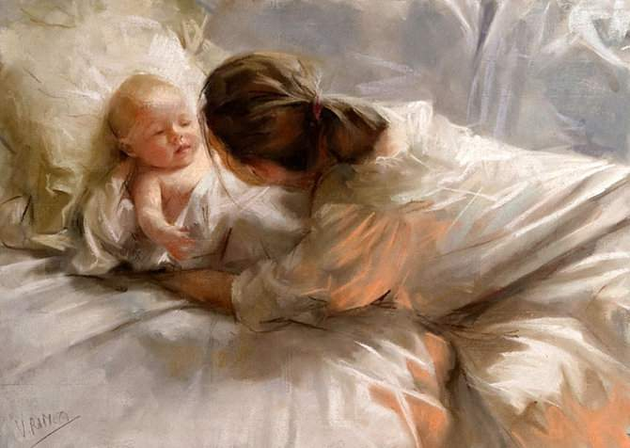

Slide 32
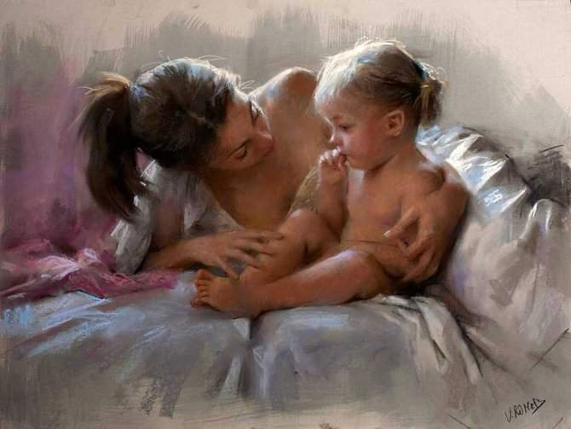

Slide 33
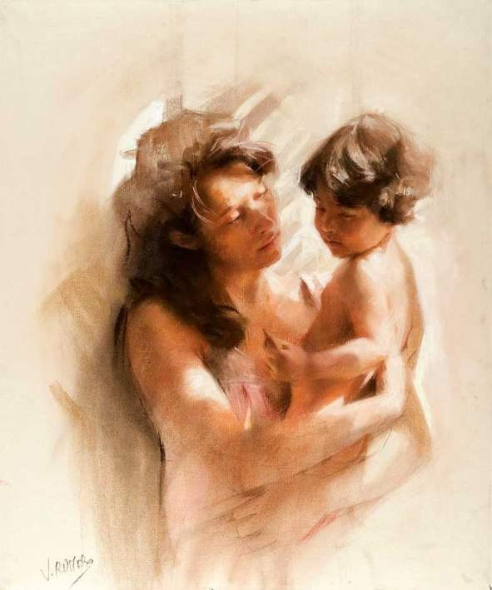
Vicente Romero Redondo was born in 1956 in Madrid as the eldest of four sons. During his childhood, his parents thought he would dedicate
his life to painting. Romero achieved his dream: he began studies at the High School for Art San Fernando, the most prestigious art school in Spain (Salvador Dali studied there from 1922-1926). During his first years he dedicated his time to sculpture, but soon realized that only by painting could he express all the sensibility he possessed and needed to transmit. He graduated with special honors in 1982. Then he spent several years working on the street, not the most comfortable but surely the most efficient way to perfect his technique. He painted pastel portraits in coast villages of the mainland and the islands of Tenerife, Majorca and Ibiza. At the close of the eighties, Romero and his wife settled in the Costa Brava. Since the early 90s Romero's paintings have been shown in individual expositions in Spain, France and Portugal. In 2001 he moved to Madrid, but he spends time as well in the Costa Brava with its incredible light, one of the most identifiable aspects of his work.
Images and text : Internet
(Paintings by Vicente Romero Redondo)
Music: Richard Clayderman - Belle
Adriana

